Slide 1





Coffee Shop Sales Analysis & Revenue Prediction
A Data Analysis & Machine Learning Project
Prepared by: Abdulwahab Almutlak
Date: 2025

Slide 2
Overview
Overview
This project analyzes over 149,000 coffee shop transactions from three store locations
The goal is to understand sales patterns and build a model that predicts daily revenue.

Slide 3

Problem Definition
📌 Business Question:
How can we understand customer purchasing behavior and predict the daily revenue of the coffee shops?
🎯 Project Objectives:
  Explore sales patterns
  Identify best-selling items
  Analyze peak hours & locations
  Build ML model to predict daily revenue

Slide 4
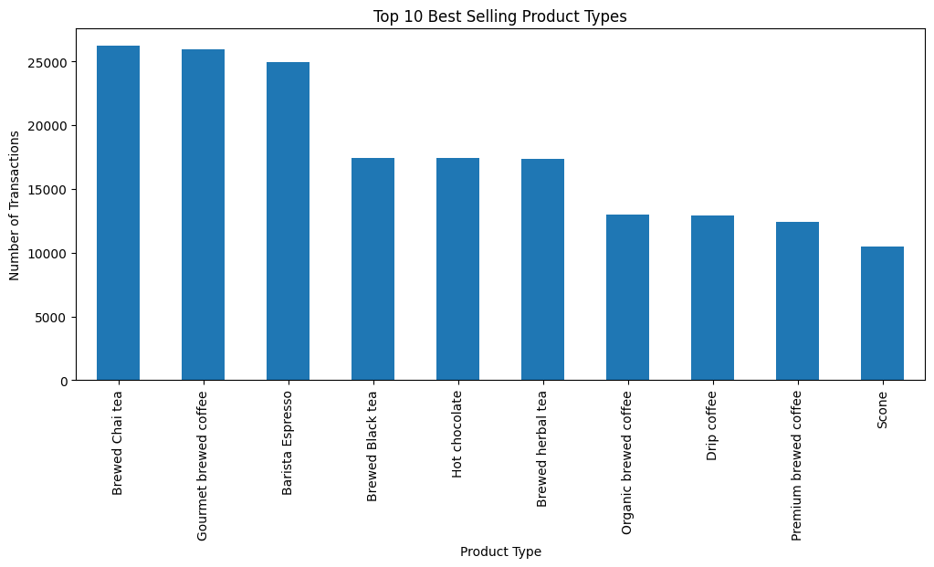
EDA
Opportunities

Slide 5
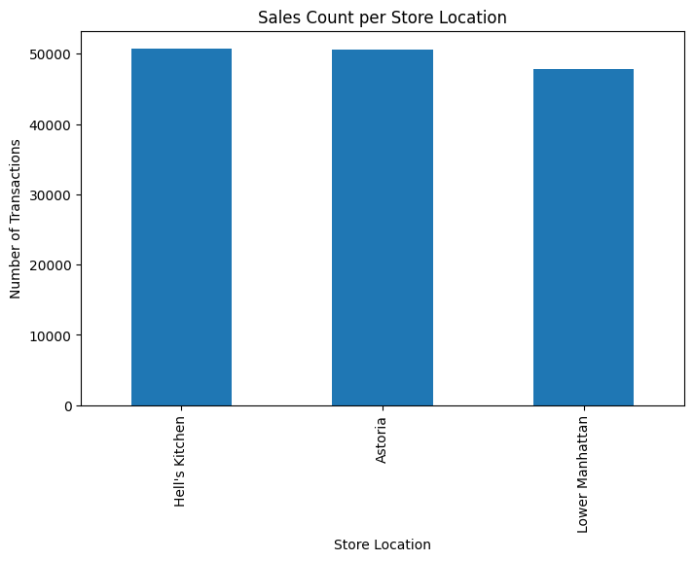
EDA

Slide 6
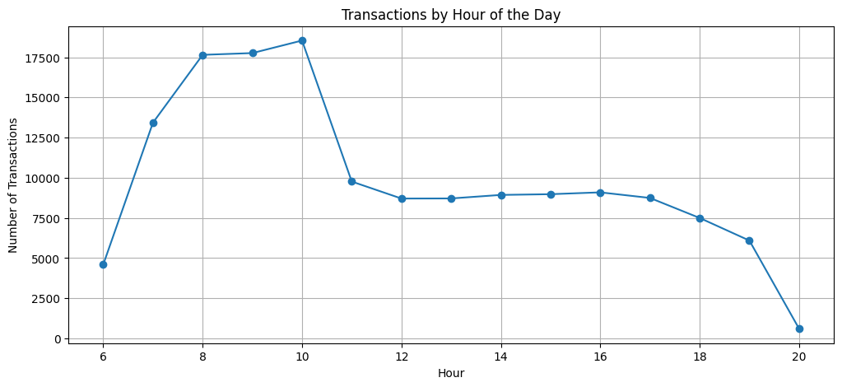
EDA

Slide 7
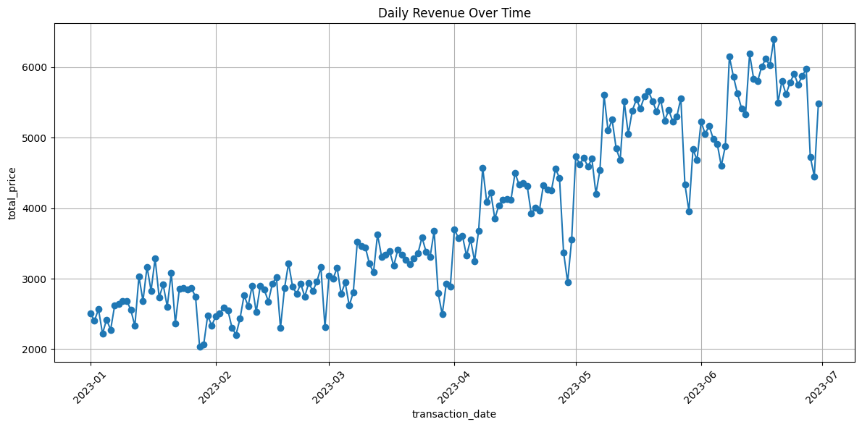
EDA

Slide 8
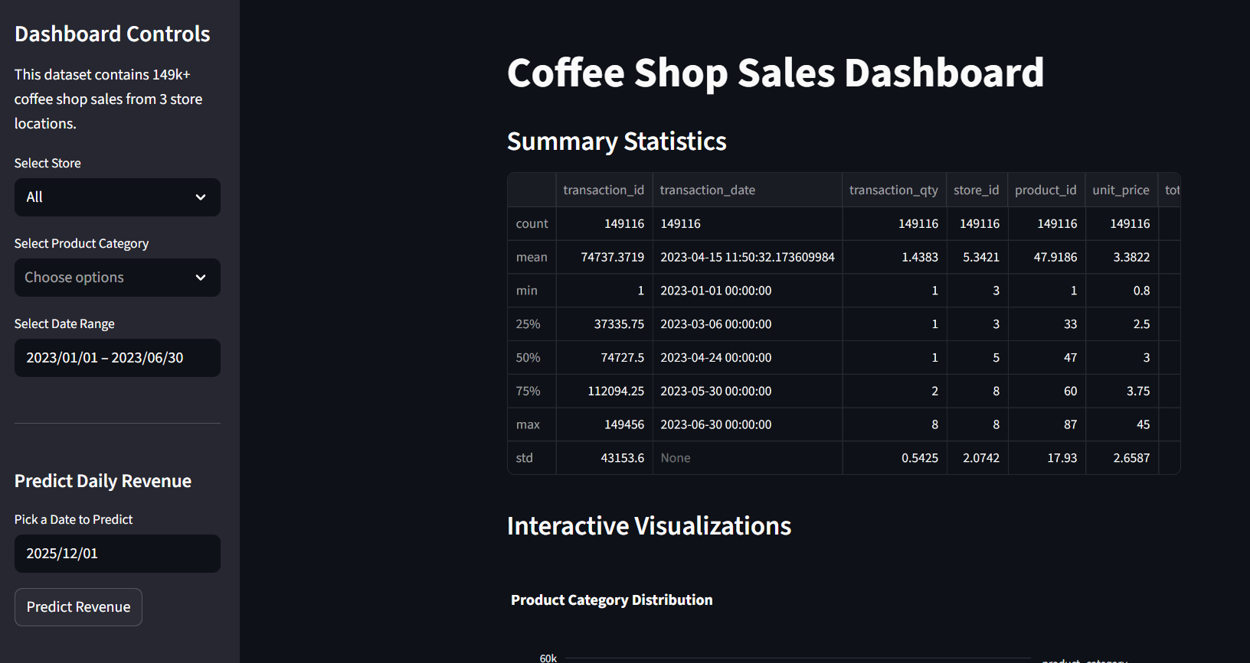
Dashboard

Slide 9

Key Insights
01
Coffee dominates total sales
02
Peak sales occur in the morning hours
03
Revenue trends increase strongly over months
04
Hell’s Kitchen & Astoria outperform Lower Manhattan

Slide 10
Conclusion
The business is stable with strong morning demand and clear best-selling categories. coffee and Tea should remain the primary focus, while low-selling items could be bundled or promoted to improve performance.

